Slide 1
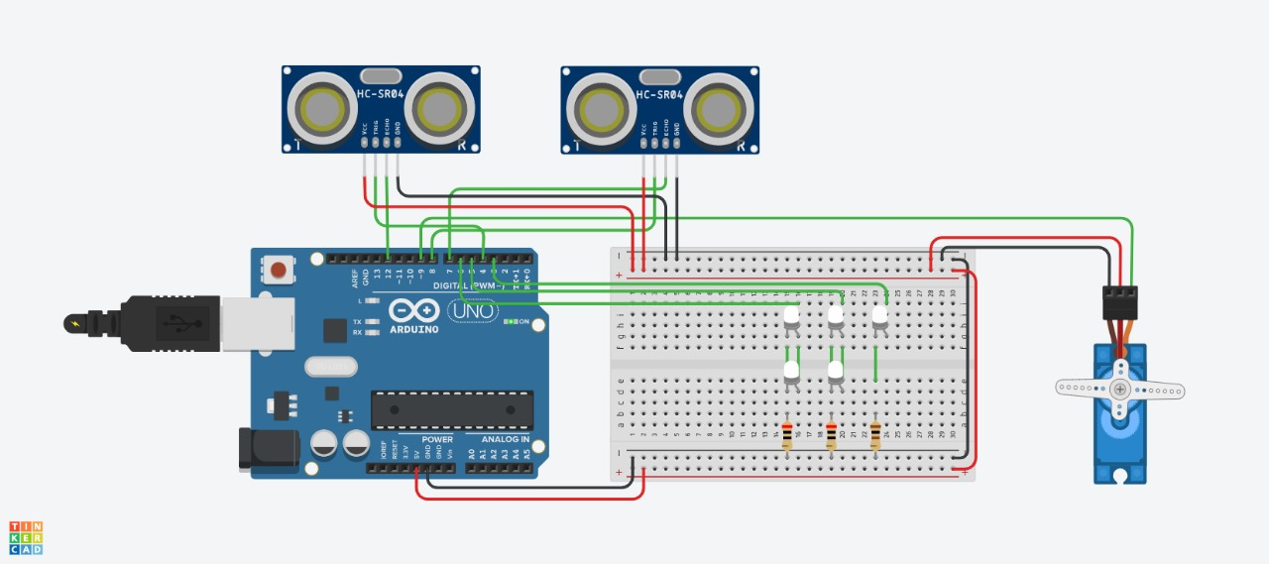
Circuit Diagram:

Slide 2
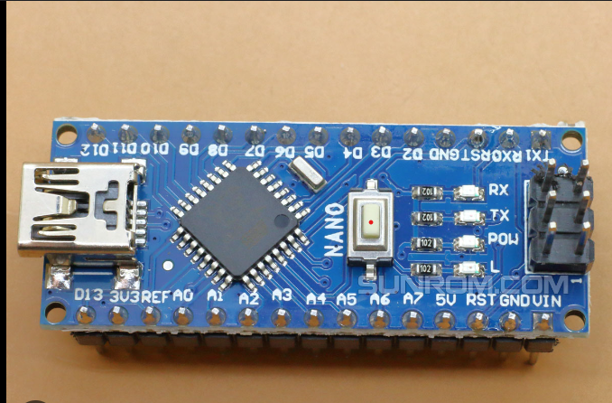
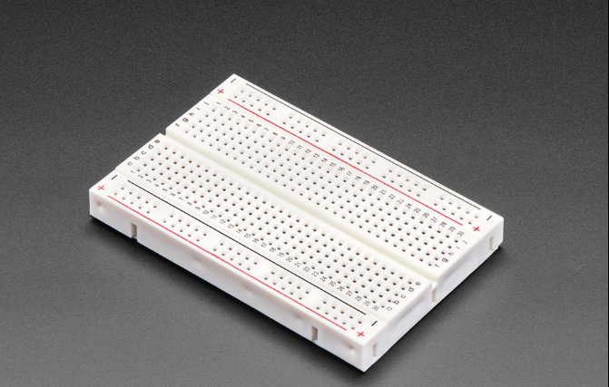
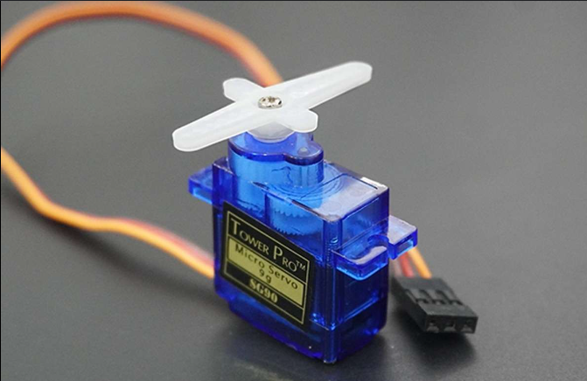
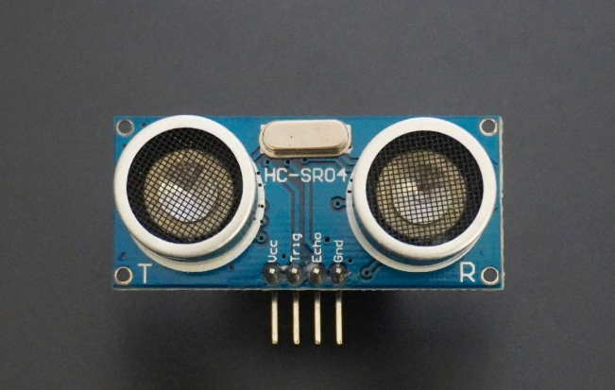
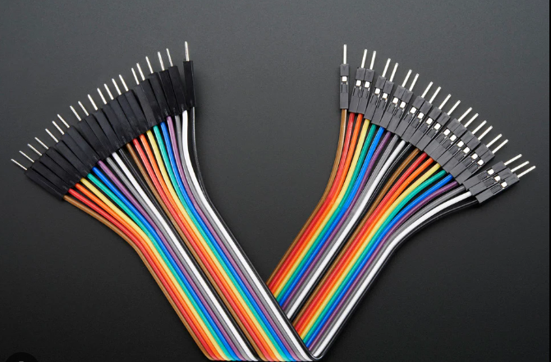
Components:
Arduino Nano
breadboard
Servo motor
ULTRASONIC SENSOR
WIRES

Slide 3
Transducers:
Component | Input | Output
Ultrasonic Sensor | Electrical Energy/Sound Energy | Sound Energy/Electrical Energy
Servo Motor | Electrical Energy | Mechanical Energy

Slide 4
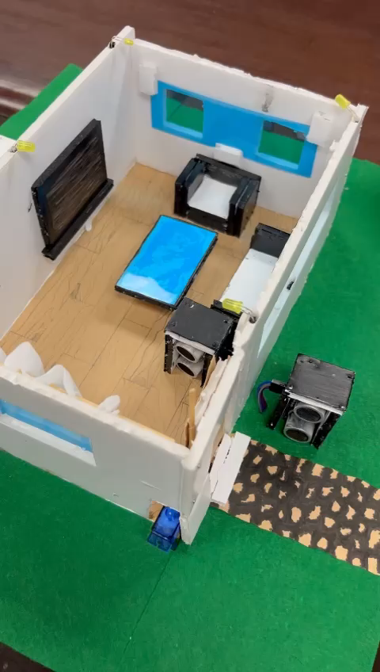
Project operation:

Slide 5


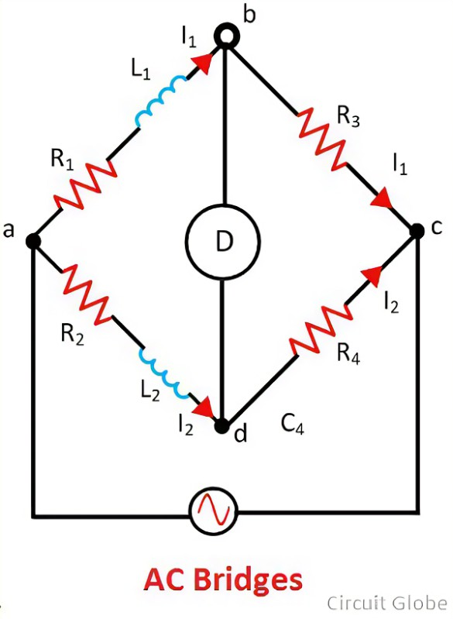
AC Bridge application:
Filter Design and Analysis:
AC circuits are used in phase shifting and filtering undesirable signals.
It’s essential for signal processing, noise reduction, and frequency selection.
For example, Designing and optimizing filters for a specific cutoff frequencies and attenuation rates for various applications.
i.e: Audio, Telecommunications, and Signal processing.

